Slide 1
Spring Framework
Benefits…
Spring enables developers to develop enterprise-class applications using POJOs.
You do not need an EJB container such as an application server
Use only robust servlet container such as Tomcat
Spring is organized in modular fashion
Worry only about the ones your need and ignore the rest
Spring makes use of the existing technologies easer
ORM frameworks (Hibernate/JPA), JEE, and other view technologies
Testing with spring is easier (Thanks to POJO’s & Spring DI)
Support for various test frameworks such as Junit, TestNG
Spring MVC – a well-designed web MVC framework
Spring provides API to translate technologic-specific exceptions into consistent, unchecked exceptions (Ex: Exceptions thrown by JDBC, Hibernate)
Spring IOC Container is lightweight compared to EJB containers
Spring has a good transaction management support (Both local [single DB] and global transactions [JTA])

Slide 2
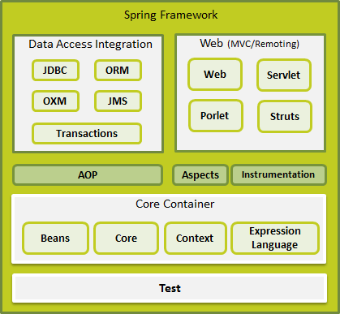
Spring Framework
Notes:
Core – IOC
Beans – Bean Factory
Context – Application Context
EL – SpEL

Slide 3
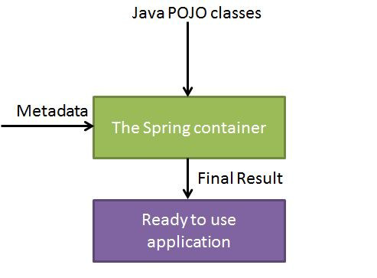
Spring IOC Container
The core of the spring framework.
Create Objects
Wire them together
Configure them
Manage their complete life cycle from creation till destruction

Slide 4
Spring Bean Life Cycle
Initialization callbacks
When a bean is instantiated (created), it may be required to perform some initialization to get it into a stable state
When a bean is no longer required and is removed from the container, some cleanup may be required
init-method / afterPropertiesSet() / @PostConstruct
Method that is called on the bean immediately upon instantiation
This method is called after the bean is created and its properties (if any) are set
destroy-method / destroy() / @PreDestroy
Method that is called just before the bean is removed from the container

Slide 5
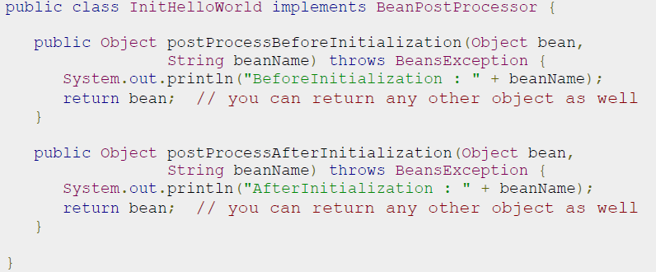
Spring Bean Life Cycle
Bean Post Processors
The BeanPostProcessors operate on bean (or object) instances which means that the spring IoC container instantiates the bean instance and then BPP interfaces do their work.
By default, Spring will not be aware of the @PostConstruct and @PreDestroy annotation. To enable it, you have to either register ‘CommonAnnotationBeanPostProcessor‘ or specify the ‘<context:annotation-config />‘ in bean configuration file,

Slide 6
Spring Bean Life Cycle
Bean Life Cycle Sequence
Bean is created / instantiated
Bean properties are set (Setter Injection)
If (BPP)
postProcessBeforeInitialization()
If (init-method)
init-method()
If (BPP)
postProcessAfterInitialization()
Bean is ready
Bean is getting destroyed
If (destry-metod)
destroy()

Slide 7
Spring AOP
Inside XML – Enabline @AspectJ Programming Module
<aop:aspectj-autoproxy/>
Define an Aspect Java Class
@Aspect
public class AspectModule {
…
}
Define the Aspect as a bean in XML
<bean id="myAspect" class="org.xyz.AspectModule">
<!-- configure properties of aspect here as normal -->
</bean>
Declare a PONITCUT in the Aspect
@Pointcut("execution(* com.xyz.myapp.service.*.*(..))") // expression
private void businessService() {} // signature
Declare an ADVICE in the Aspect
@Around("businessService()")
public void doAroundTask() {
...
}
@Before
@After
@AfterReturning
@AfterThrowing
@Around

Slide 8
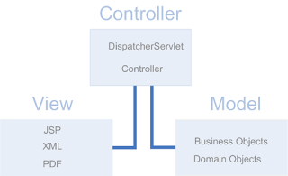
Spring MVC
Spring MVC is part of the Spring Framework as a MVC implementation
The Spring Web model-view-controller (MVC) framework is designed around a DispatcherServlet that dispatches requests to handlers
Open for extension…. Closed for modification

Slide 9
The Dispatcher Servlet
Spring MVC framework is request-driven, designed around a central Servlet that dispatches requests to controllers and offers other functionalities that facilitates the development of web applications
Spring’s DispatcherServlet is completely integrated with the Spring IoC container and as such allows you to use every other feature that Spring has
DispatcherServlet is an expression of the “Front Controller” design pattern

Slide 10
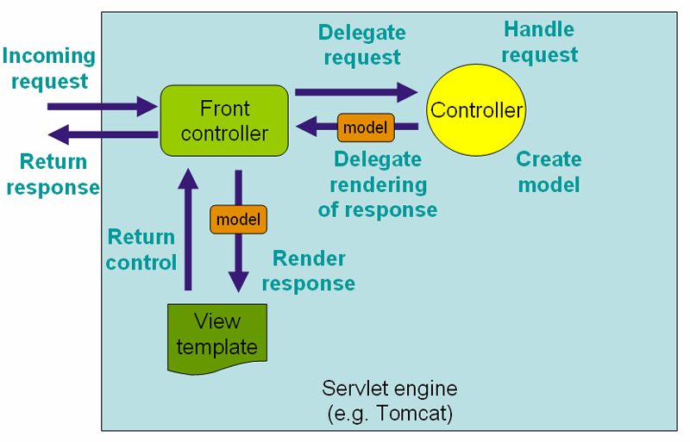
The Dispatcher Servlet

Slide 11
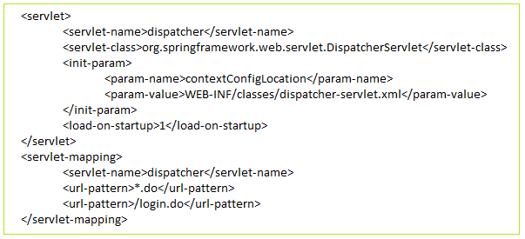
src/main/webapp/WEB-INF/web.xml
All incoming requests flow through a DispatcherServlet
DispatcherServlet is an actual Servlet (it inherits from HttpServlet base class) and as such is declared in the web.xml file.
You need to map requests that you want the DispatcherServlet to handle, by using a URL mapping in the same web.xml file

Slide 12
DispatcherServlet’s WebApplicationContext
In Spring MVC each DispatcherServlet has its own WebApplicationContext. By default, spring always looks for the context at <dispatcherServletName-servlet.xml>. However this can be overridden with a Servlet init-param
The DispatcherServlet related WebApplicationContext should have MVC-specific configurations such as Controllers, HandlerMappings, ViewResolvers etc…,

Slide 13
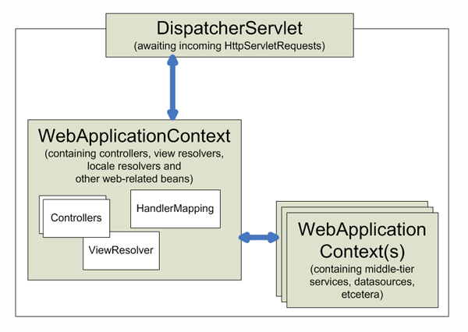
ROOT WebApplicationContext
Other non MVC-specific configuration such as the beans for service or persistence layer should be in root WebApplicationContext.
In SpringMVC the root WebApplicationContext is bootstrapped by using ContextLoadListener specified as Listener in web.xml.
So the DispatcherServlet WebApplicationContext will inherit (extend) from the ROOT WebApplicationContext

Slide 14
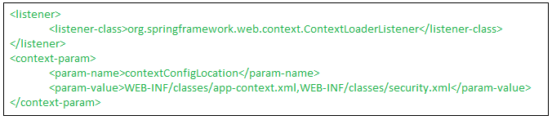
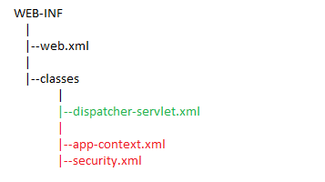
ROOT WebApplicationContext

Slide 15

Handler Mappings
HandlerMapping is the class that helps DispatcherServlet to map an incoming request to a particular Controller class.
There are many HandlerMapping implementations in Spring, however the most used one is the annotated controllers
HandlerMapping bean has one important property – interceptors to which a user defined handler interceptor can be injected
RequestMappingHandlerMapping
This HandlerMapping implementation automatically looks for @RequestMapping annotations on all @Controller beans
The RequestMappingHandlerMapping is the only place where a decision is made about which method should process the request
<mvc:annotation-driven />
This annotation in the DispatcherServlet WebApplicationContext (file: /WEB-INF/classes/dispatcher-servlet.xml), will automatically register the RequestMappingHandlerMapping bean

Slide 16
WEB-INF/classes/dispatcher-servlet.xml
Import any other context configuration files. For example to import the main ROOT application context file:
<import resource="app-context.xml"/>
Configure the @Controller programming model
<mvc:annotation-driven />
Configure all the View Resolvers
TilesViewResolver (and TilesConfigurer)
JSPViewResolver
MultiPartResolver
ExceptionResolver
CookieLocaleResolver

Slide 17
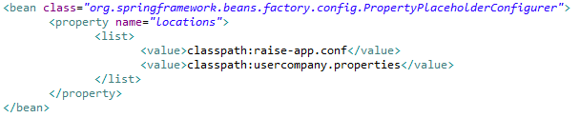
WEB-INF/classes/app-context.xml
Initiate a component scan
Configure a property place holder configurer
Note that at run-time, these property files will typically be placed at: /WEB-INF/classes folder so they get detected in the classpath scanning

Slide 18
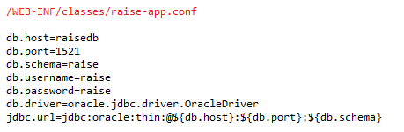
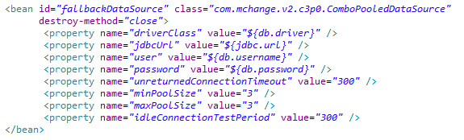
WEB-INF/classes/app-context.xml
Property place holder configurer (This is a BeanFactroy PostProcessor)
Sample Contents
How to use
spring bean lifecycle callback method

Slide 19
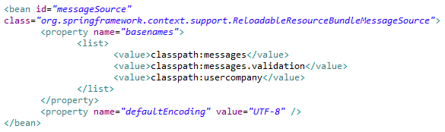
WEB-INF/classes/app-context.xml
Configure Resource Bundle Message Resource (i18n)
Note that at run-time, these properties files will typically be placed at: /WEB-INF/classes folder so they get detected in the classpath scanning
The basenames property of the messageSource bean will by default look for files with the “.properties” extension.

Slide 20

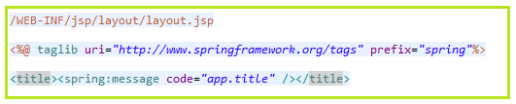
WEB-INF/classes/app-context.xml
i18n
There should be multiple resource messages files one for each locale
messages.properties – Default and English
messages_zh_CN.properties – Chinese
Sample Contents
How to use (Say in JSP)
We will use the Spring TagLib

Slide 21
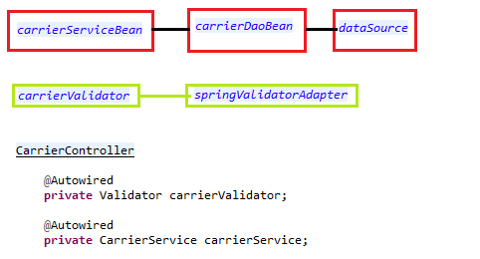
WEB-INF/classes/app-context.xml
Session Factory (Depends on DataSource)
Spring support for hibernate LocalSessionFactory
dataSource
mappingLocations – List of *.hbm.xml files
hibernateProperties – Such as show_sql, dialect etc…,
Other Service & Repository Beans (One example shown below)

Slide 22
View Resolver
All the handler methods in the controller class must resolve to a logical view name explicitly by returning a String
ViewResolver interface
Provides a mapping between view names and the actual views
There are many implementation is spring, but the prominent ones used are InternalResourceViewResolver and TilesViewResolver

Slide 23
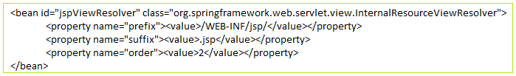
InternalResourceViewResolver
What’s internal resource views? In Spring MVC or any web application, for good practice, it’s always recommended to put the entire views or JSP files under “WEB-INF” folder, to protect it from direct access via manual entered URL. Those views under “WEB-INF” folder are named as internal resource views, as it’s only accessible by the servlet or Spring’s controllers class.
In Spring MVC, InternalResourceViewResolver is used to resolve “internal resource view” (in simple, it’s final output, jsp or html page) based on a predefined URL pattern. In additional, it allow you to add some predefined prefix or suffix to the view name (prefix + view name + suffix), and generate the final view page URL.
If let’s say controller returns a string “carrierDetails”; the actual (physical) view it resolves to is
/WEB-INF/jsp/carrierDetails.jsp

Slide 24
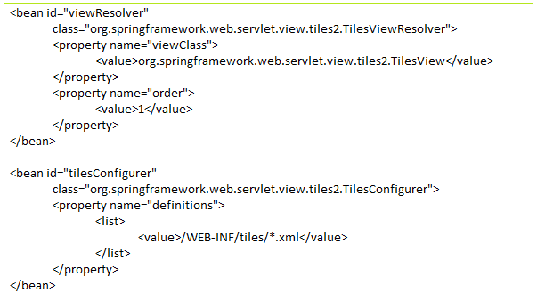
TilesViewResolver
Resolves view names to protected .jsp resources within the /WEB-INF/jsp directory
TilesConfigurer is input with configuration files that are located at
/WEB-INF/tiles/*.xml

Slide 25
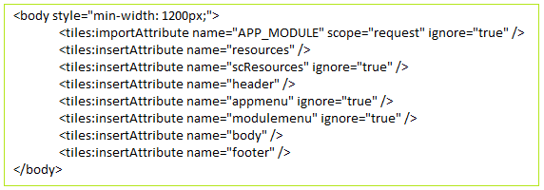
/WEB-INF/tiles/tiles.xml
In tiles.xml we have defined a template “base.definition“
This layout has a base template jsp = /WEB-INF/jsp/layout/layout.jsp in which attributes (as place holders) are defined.
This layout contains attributes such as
resources - /WEB-INF/jsp/layout/resources.jsp
Header - /WEB-INF/jsp/layout/header.jsp
appmenu - /WEB-INF/jsp/layout/appmenu.jsp
body – “”
footer - /WEB-INF/jsp/layout/footer.jsp
This layout is then extended and if required, the attributes are overridden
/WEB-INF/jsp/layout/layout.jsp

Slide 26


/WEB-INF/tiles/industry-tiles.xml
In industry-tiles.xml the base layout is extended for view carrier
The body attribute is overridden with the actual JSP (listCarriers.jsp) which will render the view to populate with the Carrier Objects.
Now from a Controller class, we return the logical view name which will not be a jsp name but rather a tiles definition name

Slide 27
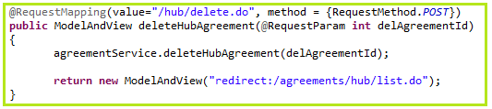
Redirecting to views
Redirect – redirect:
A Note on InternalResourceViewResolver
Convenient subclass of UrlBasedViewResolver that supports InternalResourceView (in effect, Servlets and JSPs) and subclasses such as JstlView and TilesView. You can specify the view class for all views generated by this resolver by using setViewClass(..).
If a view name is returned that has the prefix redirect:, the UrlBasedViewResolver (and all subclasses) will recognize this as a special indication that a redirect is needed. The rest of the view name will be treated as the redirect URL.
In this example, the controller handler method does a “delete” operation and after this it is desirable that the user is presented back with the list of objects. So here the response is delegated to another controller method – Here in this case, the list.do URL is called again by the client.

Slide 28
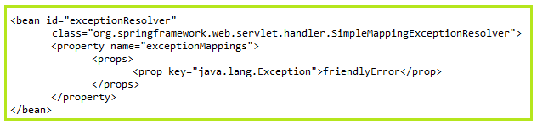
ExceptionResolver - Handling Exceptions in a generic way
SimpleMappingExceptionResolver
Takes the class name of any exception (ex: java.lang.Exception) that might be thrown from a handler method and map it to a view name.
Map exception class names to view names
Specify a default (fallback) error page for any exception not handled anywhere else
Configuration
annotation - @ExceptionHandler(Exception.class) – Place this on the @Controller method(s)
friendlyError.jsp

Slide 29
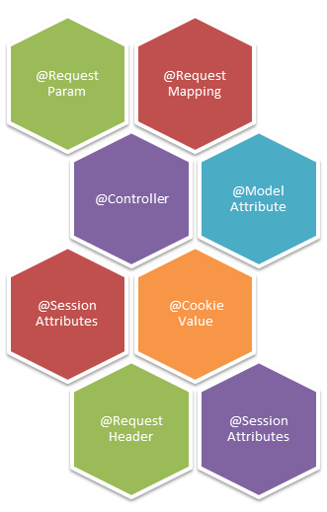
Annotations, annotations and annotations everywhere….
as

Slide 30
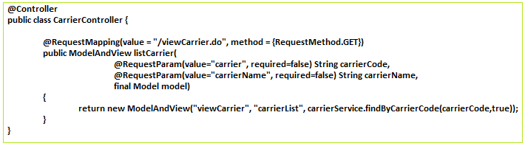
Implementing Controllers
Controllers provide access to the application behavior that you typically define through a service interface
Controllers interpret user input and transform it into a model that is represented to the user by the view
In this example, the method is called for a URL – “…/app-name/viewCarrier.do”
Call from a JSP: <a href="viewCarrier.do"><spring:message code='carrier.label' /></a>
The methods takes Model as input parameter and return a Model and View Object – The View is a string which is mapped either to a tiles definition name or an actual jsp file

Slide 31
@Controller
The @Controller annotation indicates that a particular class serves the role of a controller
Is a stereotype annotation extending from @Component.
The DispatcherServlet scans such annotated classes for mapped methods and detects @RequestMapping annotations (see next slides)
<context:component-scan base-package="com.tnsi" />

Slide 32
@RequestMapping
@RequestMapping is used to map URLs such as /viewCarrier.do onto a methods in the Controller class
Can be used both at class level and methods levels
Typically the class-level annotation maps a specific request path (or path pattern) onto a form controller, with additional method-level annotations narrowing the primary mapping for a specific HTTP method request method ("GET", "POST", etc.) or an HTTP request parameter condition.
Spring 3.1+
The RequestMappingHandlerMapping is the only place where a decision is made about which method should process the request
Think of controller methods as a collection of unique service endpoints with mappings for each method derived from type (class level) and method-level @RequestMapping information

Slide 33
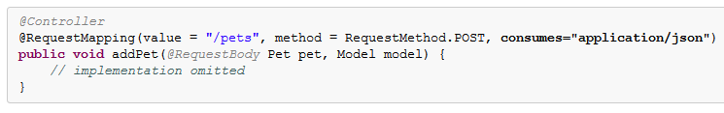
Consumable Media Types
You can narrow the primary mapping by specifying a list of consumable media types. The request will be matched only if the Content-Type request header matches the specified media type. For example:
Note that in the above example, the request data is sent as part of the HTTP request body which is bind to the method parameter using the @RequestBody annotation

Slide 34
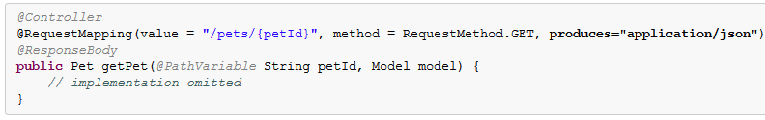
Producible Media Types
You can narrow the primary mapping by specifying a list of producible media types. The request will be matched only if the Accept request header matches one of these values. Furthermore, use of the produces condition ensures the actual content type used to generate the response respects the media types specified in the produces condition. For example:
Note that in the above example, the response data is sent back to the client as HTTP response (Not to a view) using the @ResponseBody annotation.
Spring does the automatic conversion of the returned object to a HTTP Response to a format of JSON or XML – Spring uses Jackson for JSON and JAXB for XML

Slide 35
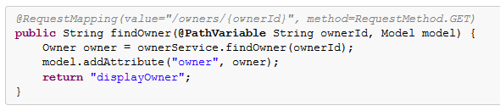
URI Template Patterns - @PathVariable
URI Template
Is a URI-like string, containing one or more variable names
http://www.example.com/users/{userId} – variable name is userId
When you substitute values for these variables, the template becomes a URI
Assigning the value arun to the variable yields http://www.example.com/users/arun.
Use the @PathVariable annotation on a method argument to bind it to the value of a URI template variable
The URI Template " /owners/{ownerId}" specifies the variable name ownerId. When the controller handles this request, the value of ownerId is set to the value found in the appropriate part of the URI. For example, when a request comes in for /owners/arun, the value of ownerId is arun
This is the beginning of Spring RESTful services

Slide 36
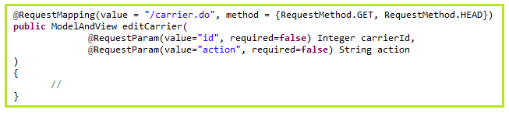
@RequestParam
Use the @RequestParam annotation to bind request parameters to a method parameter in your controller
The above method can be invoked something like below:
var actionUrl = "carrier.do?action=" + action + "&id=" + id;
Note that the request params (action & id) are passed as part of the request URL
Parameters using this annotation are required by default, but you can specify that a parameter is optional by setting @RequestParam's required attribute to false
Type conversion is applied automatically if the target method parameter type is not String

Slide 37
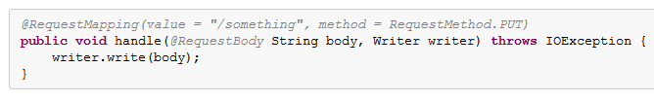
@RequestBody
The @RequestBody method parameter annotation indicates that a method parameter should be bound to the value of the HTTP request body. For example:
HttpMessageConverter is responsible for converting from the HTTP request message to an object and converting from an object to the HTTP response body.
The RequestMappingHandlerAdapter supports the @RequestBody (and @ResponseBody) annotations with the a set of default HttpMessageConverters
The <mvc:annotation:driven /> configuration in the DispatcherServlet context configuration will enable the RequestMappingHandlerMapping and RequestMappingHandlerAdapter beans.

Slide 38
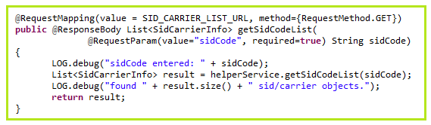
@ResponseBody
This annotation can be put on a method and indicates that the return type should be written straight to the HTTP response body (and not placed in a Model, or interpreted as a view name). For example:
The above example will result in the object “SidCarrierInfo” representation (Example: JSON, XML etc..,) being written to the HTTP response stream.
As with @RequestBody, Spring converts the returned object to a response body by using an HttpMessageConverter.

Slide 39
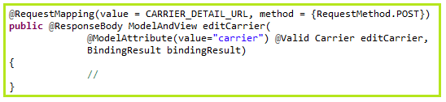
@ModelAttribute
An @ModelAttribute on a method argument indicates the argument should be retrieved from the model.
For the object in the model, the argument’s fields should be populated from all request parameters that have matching names. This is known as data binding in Spring MVC.
This is usually used when the form-backing (or command) object is filled up and submitted from the client form.

Slide 40
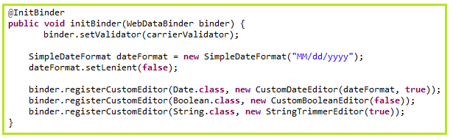
@InitBinder
Annotating controller methods with @InitBinder allows you to configure web data binding within your controllers
@InitBinder identifies methods that initialize the WebDataBinder that will be used to populate command and form object arguments of annotated handler methods
The following example demonstrates the use of @InitBinder to configure a CustomDateEditor for all java.util.Date form properties. It also sets the validator implementation to the binder (More on this later)

Slide 41
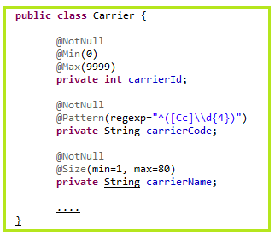
@Valid (JSR 303)
In Spring, you can enable “mvc:annotation-driven” to support JSR303 bean validation via @Valid annotation on the handler method parameter, if any JSR303 validator framework is in the classpath
Hibernate Validator is the RI for JSR303
On the model class, add hibernate validator annotations such as @NotNull, @NotEmpty, @Range, @Min, @Max etc…,
0 to 9999
@Pattern (regex)
Start with “C” or “c”
Followed by exactly 4 digits
1 to 80 chars

Slide 42
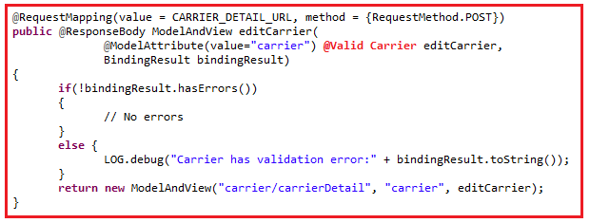
@Valid (JSR 303)
An @RequestBody method parameter can be annotated with @Valid, in which case it will be validated using the configured Validator instance.
The validator was initialized using @InitBinder (from previous slides)
Validator runs the validation code and based on PASS/FAIL, it sets the BindingResult
BindingResult will now examined in the Controller as shown above for any errors

Slide 43
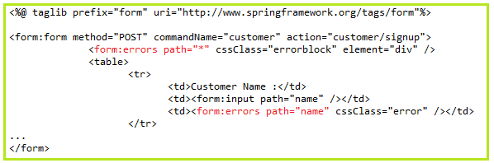
@Valid (JSR 303) – JSP
If there are any validation errors, they will be automatically bind to the model object
On the JSP Page, using Spring custom tags, we can display the error messages:

Slide 44
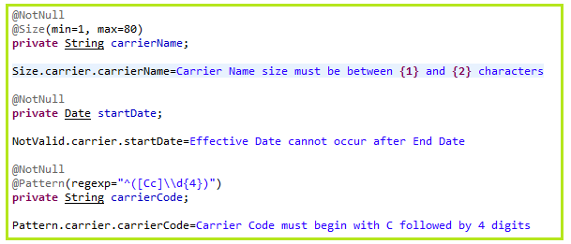
@Valid (JSR 303) – Error Messages
There are default error messages that will be displayed for each of the JSR 303 validation annotations.
This can be overridden in the message resources as key value pairs.
Key is @annotationName.object.feildName
objectname here refers to the command/model object name (reference) used in the JSP

Slide 45
References
Theory
http://docs.spring.io/spring/docs/3.0.x/reference/mvc.html
http://docs.spring.io/spring/docs/2.5.6/reference/mvc.html
Examples
http://www.mkyong.com/tutorials/spring-mvc-tutorials/

Slide 46
BACKUP
Back Up Slides for Spring MVC 2.5.x

Slide 47
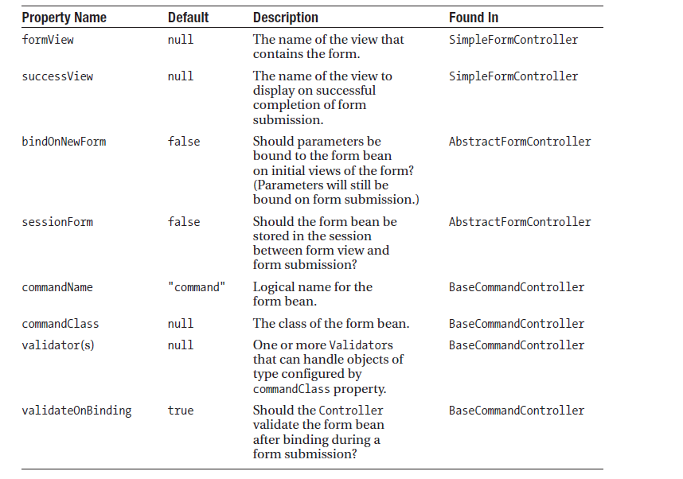
SimpleFormController

Slide 48
formView
Create an instance of the form object (a.k.a command bean)
Using the formBackingObject() method
By default this method will return an instance of the class specified with setCommandClass() (remember commandName & commandClass properties?)
formBackingObject() can be overridden to manipulate the form object before it enters the formView
Creates the DataBinder and calls the initBinder()
Override this method to register any custom PropertyEditors required when binding to the form object
At this point, the view (formView) is ready to be rendered to the user. But before this…
referenceData() call-back method is called
This life cycle method allows you to assemble and return any auxiliary objects required to render the view. The form object will automatically be sent to the view, so use this method to put anything else into the model the form page might need.

Slide 49
Form Submission with the onSubmit() method
Create an instance of the form object (a.k.a command bean)
Using the formBackingObject() method
Creates the DataBinder and calls the initBinder()
Override this method to register any custom PropertyEditors required when binding to the form object
With the form bean created , and the DataBinder created , the request parameters are now bound to the form bean
Allow each configured validator (thru the validator property) to validate the form bean object
After validation, the controller makes a decision based on whether any error exists
If there are any errors – display the original form view
The referenceData() method is called once more to populate the model with object for the form. Finally, the form view is displayed again, with the errors and the form bean
If no error exists – Then the form bean can finally be processed in the onSubmit()method

Slide 50
Spring custom tags <spring:bind path=“comamndName.attributeName” > .... </spring:bind>
<spring:bind path="carrier.carrierName">
<td><input name="<c:out value="${status.expression}"/>" value="<c:out value="${status.value}"/>" /></td>
</spring:bind>
The <spring:bind> tag extracts information about a single field (“carrierName" in this example) from the command object (named “carrier" in this case) and places it in a status variable.
${status.expression} contains the name that the field should have and ${status.value} contains the value of the field (blank initially, but populated with previously submitted values if the form is redisplayed after submission errors).
New Way
<form:form commandName=“carrier">
<td><form:input path=“carrierName” /></td>
</form:form>
The "comandName" attribute tells the form the name of the command object that contains our form data (specified in your form controller by calling setCommandName())
The "path" attribute gives the command object property that will be bound to the input field. Unlike the "path" attribute in <spring:bind> I didn't have to specify the command name here because the <form:form> tag already identifies the command object we'll binding to.

